Slide 1
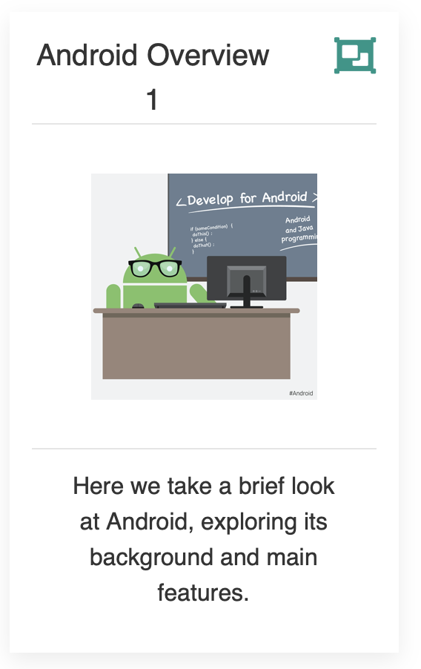
Introducing Android
Part 1

Slide 2
Agenda
Origins, Background & Previous Versions
Latest Features & New Version
Adoption Rates & The Mobile OS War
FairPhone

Slide 3
Android Origins
2003 (October) - Android Inc. founded in Palo Alto by Andy Rubin
2005 (August) – Google acquires Android Inc.
2007 (November) – OHA established (next few slides)
2008 (October 22nd) – 1st Android phone launched by HTC, the HTC Dream / Mobile G1
Notes:
Fun Fact - He was nicknamed "Android" by his co-workers at Apple in 1989 due to a love of robots undisclosed price of around $50 million
The net worth of Android is estimated to be over $2.5 billion (2020)

Slide 4
Android Origins
2003 (October) - Android Inc. founded in Palo Alto by Andy Rubin
2005 (August) – Google acquires Android Inc. 2007 (June 29th) – 1st iPhone Released
2007 (November) – OHA established (next few slides)
2008 (October 22nd) – 1st Android phone launched by HTC, the HTC Dream / Mobile G1
Notes:
Fun Fact - He was nicknamed "Android" by his co-workers at Apple in 1989 due to a love of robots undisclosed price of around $50 million
The net worth of Android is estimated to be over $2.5 billion (2020)

Slide 5
Background – Platform & OHA
Android is a comprehensive open source platform designed for mobile devices
It is championed by Google and owned by the Open Handset Alliance (80+ companies, next Slide)
The goal of the alliance is to “accelerate innovation in mobile and offer consumers a richer, less expensive, and better mobile experience.” (November 2007)
Notes:
All in response to Apple and the release of the iPhone only months previous (June 29th 2007)

Slide 6
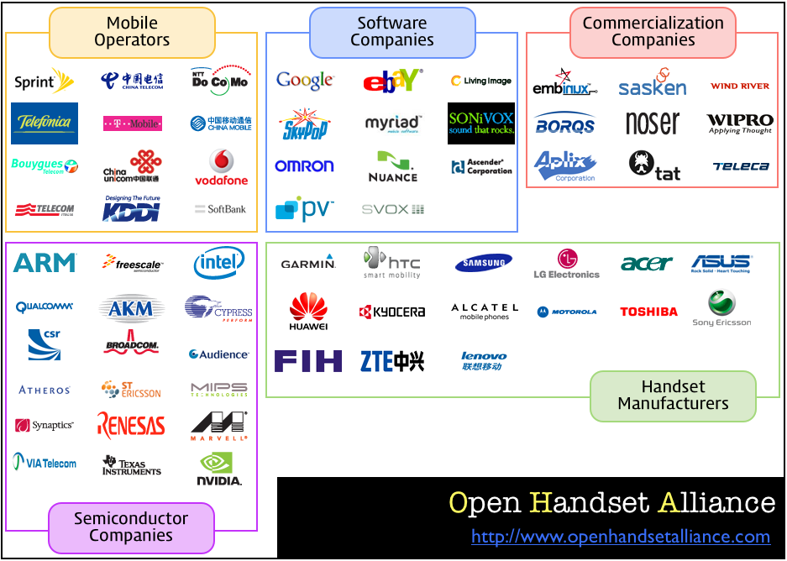

Slide 7
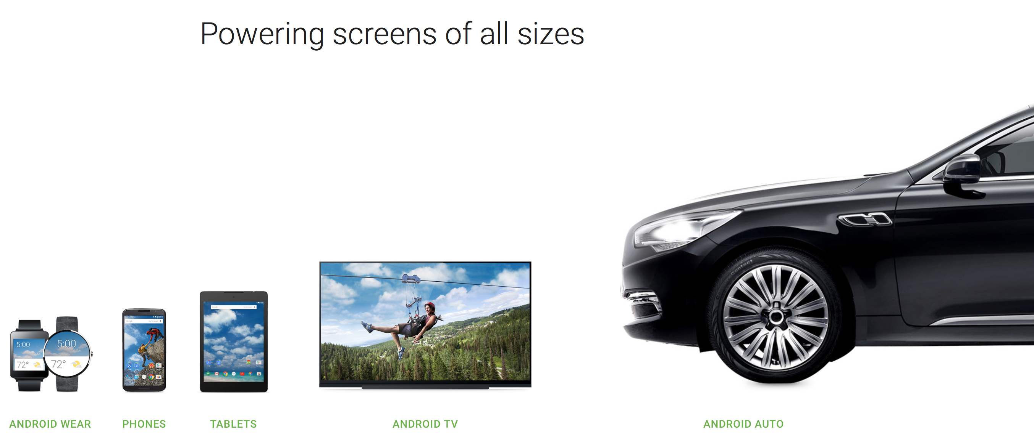
Background – Vs iOS
Android, along with iOS, has (and continues to) revolutionise the mobile space.
Unlike iOS however, Android is an open platform that separates the hardware from the software that runs on it.
This allows for a much larger number of devices to run the same applications and creates a much richer ecosystem for developers and consumers.
Notes:
And Don’t forget Android Things

Slide 8
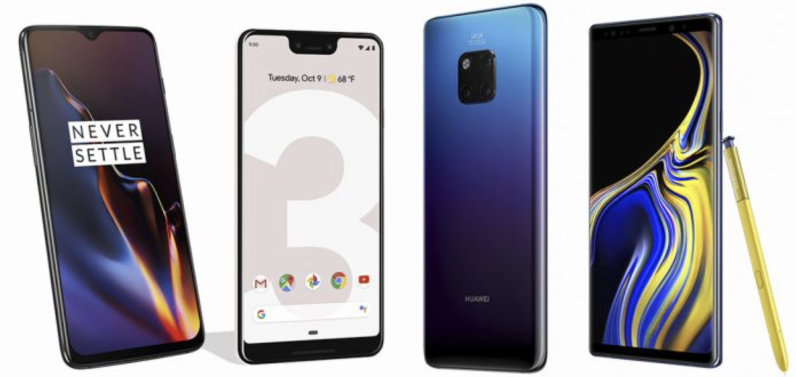
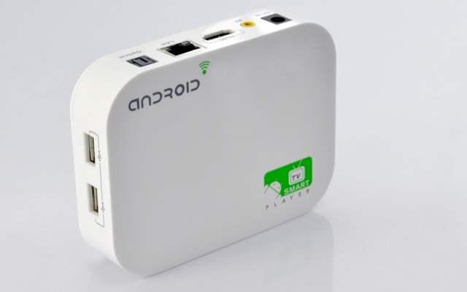
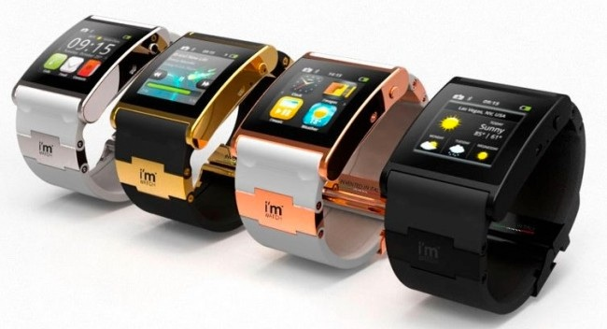
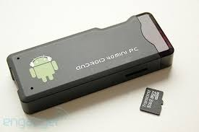
Designed for Mobile Devices
When designing Android, the team looked at which mobile device constraints were likely not going to change for the foreseeable future:
Battery power, and battery performance is probably not going to get massively better anytime soon
In general, the small size of mobile devices means that they will always be limited in terms of memory and speed
However, a device’s screen size, resolution, chipset may vary considerably
These constraints have been taken into consideration throughout the platform.
Introduction to Android
Notes:
The developer has to take these constraints into account also

Slide 9
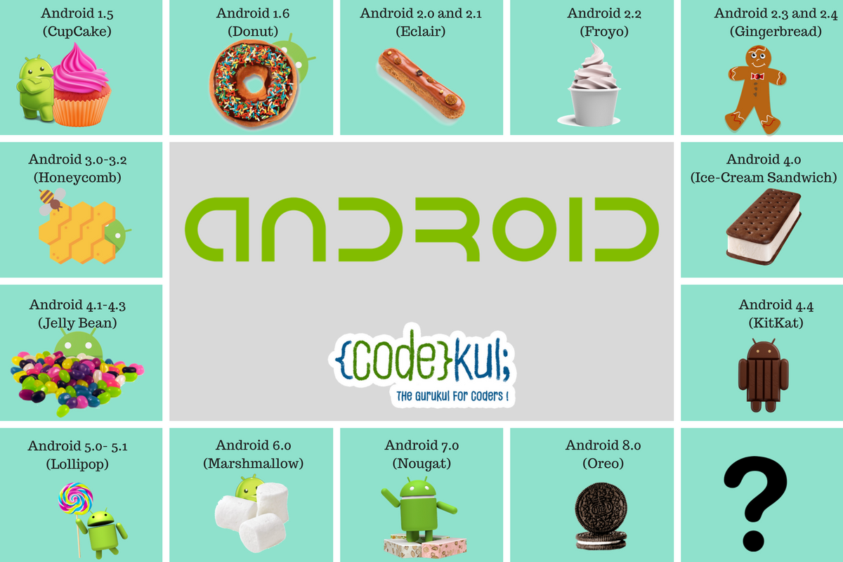

Android Versions so Far *
Android 9.0 (Pie)

Slide 10

Android Versions so Far *
Android 10 (API 29) as of September 3rd 2019
Android 9.0 (Pie)

Slide 11
Android Version 10 - Highlights
Official Release Date September 3rd 2019 (1st Beta March 13th)
For the first time ever, it won’t be named after a sweet, treat or dessert
Rolled out for Google Pixel range (+ some other OEMs, Huawei, OnePlus, LG, Nokia)
Improvements and updates fall into three main categories:
Innovation
Security & Privacy, and
Digital Wellbeing
Notes:
The reasoning there is that numbers are universal and more easily recognizable (than a treat!) And apple use numbers lol ☺

Slide 12
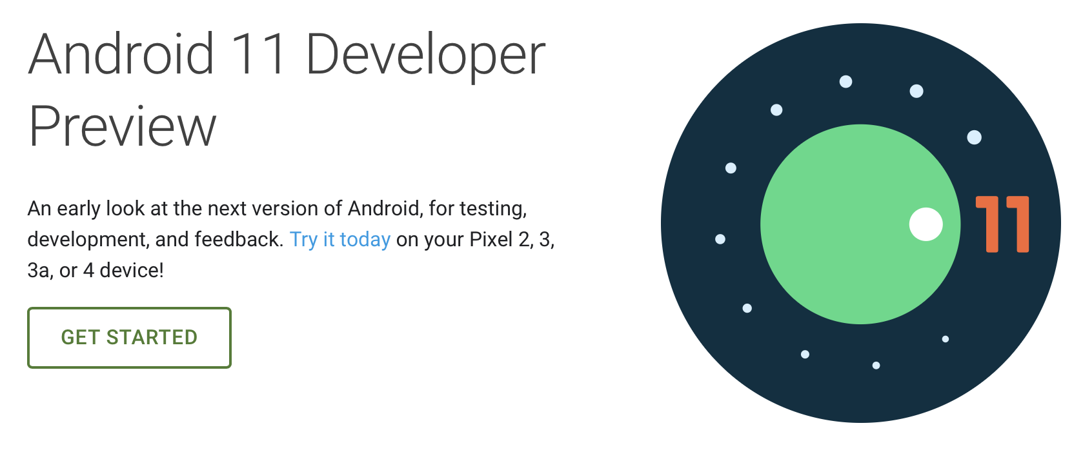
The Next Version

Slide 13
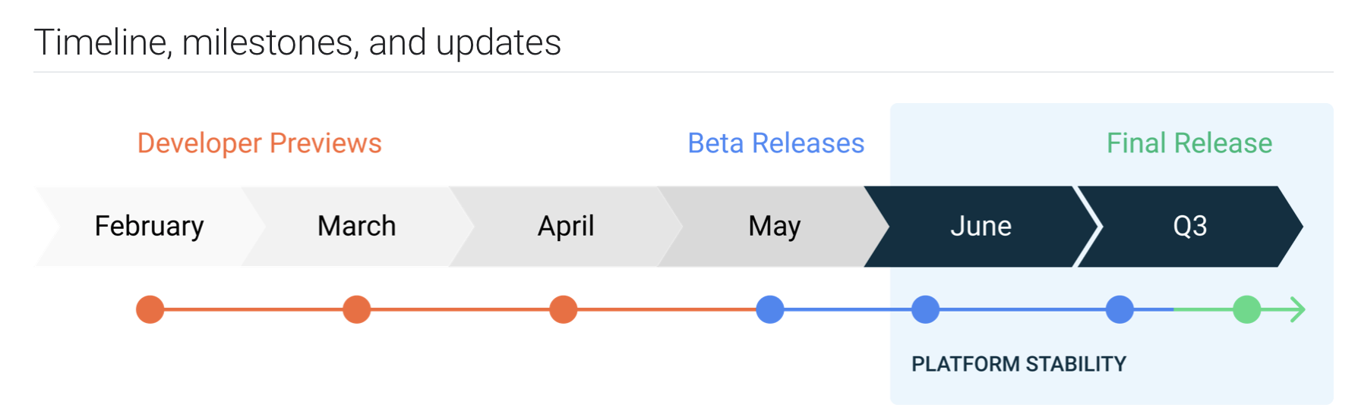
The Next Version
Notes:
The Android 11 Developer Preview program runs from February 2020 until the final public release to AOSP and OEMs, planned for Q3 2020

Slide 14
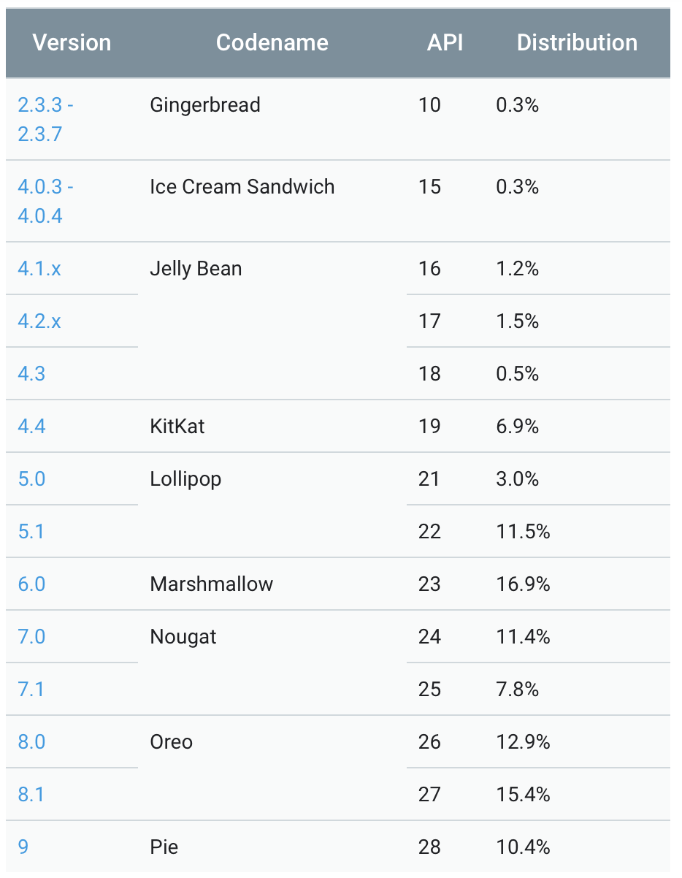
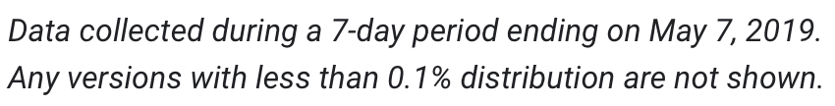
Versions – API Level *
The Android version number itself partly tells the story of the software platform’s major and minor releases. What is most important is the API level. Version numbers change all the time, sometimes because the APIs have changed, and other times because of minor bug fixes or performance improvements.
As an application developer, you will want to make sure you know which API level your application is targeting in order to run. That API level will determine which devices can and cannot run your application.
https://developer.android.com/about/dashboards

Slide 15
Versions – API Level *
The Android version number itself partly tells the story of the software platform’s major and minor releases. What is most important is the API level. Version numbers change all the time, sometimes because the APIs have changed, and other times because of minor bug fixes or performance improvements.
As an application developer, you will want to make sure you know which API level your application is targeting in order to run. That API level will determine which devices can and cannot run your application.
https://developer.android.com/about/dashboards

Slide 16
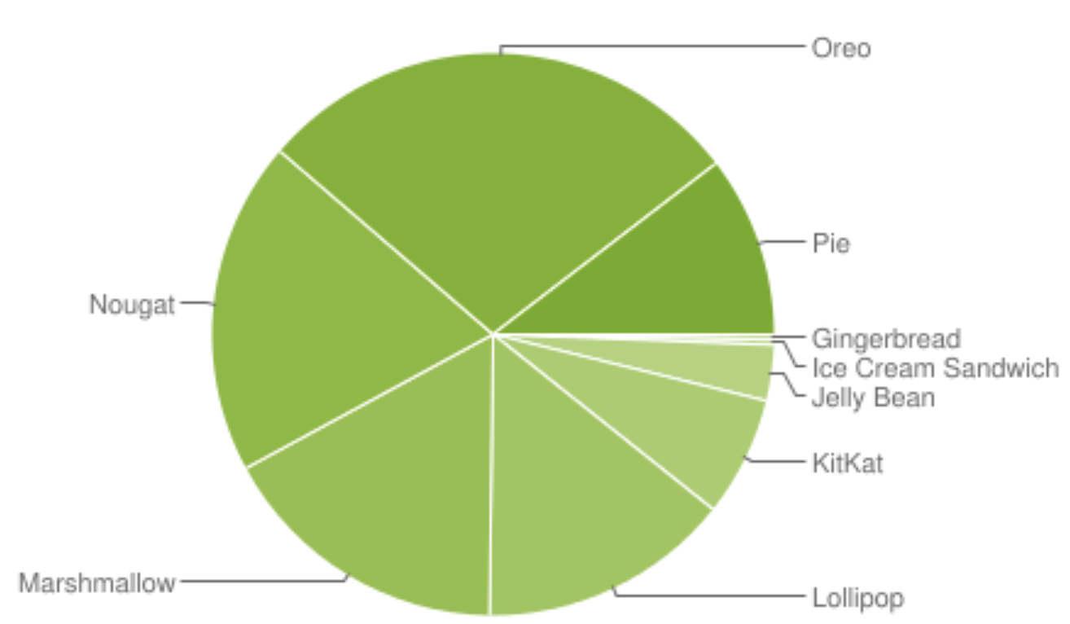
Versions – Platforms *
64.4%

Slide 17
Adoption Rates
Android adoption traditionally lags behind Apple's because Apple can make its latest iOS available for all users at once because it makes all the hardware and the software.
Android, on the other hand, is much more fragmented. Because Google lets many different hardware makers use its Android software, it can't control when all phones update to the latest software. So, the newest version of Android is always made available for Google's lineup of smartphones and tablets, but it can't release software updates to every single Android phones at once.
Smartphone manufacturers often add their own modifications to Android, which means that the update needs to be approved by each individual carrier first.
This means that depending on which phone you own, it could take ages to receive the latest software update.
Here’s some stats:

Slide 18
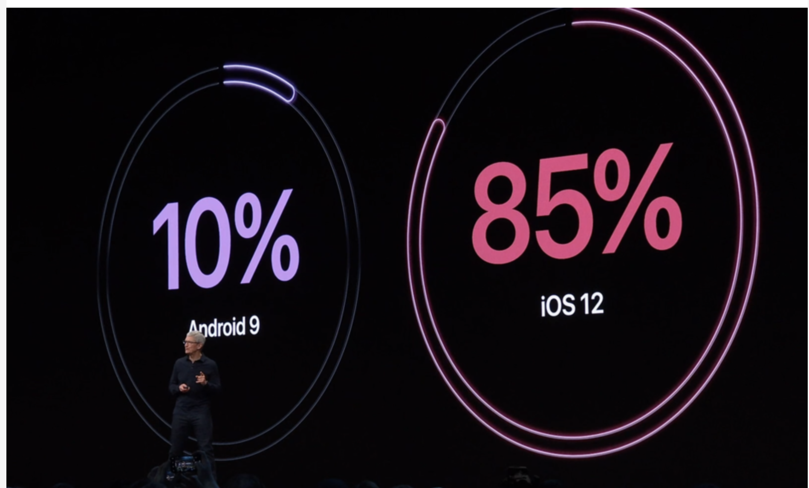
Adoption Rates (June 4th 2019 WWDC)
CEO Tim Cook was keen to point out, Apple’s latest numbers are in stark contrast to the latest offering from “those other guys.”
Notes:
Ios 12 hit 50% in 23 days

Slide 19
Adoption Rates
https://venturebeat.com/2019/10/17/as-ios-13-hits-50-adoption-android-fragmentation-keeps-getting-worse/
Notes:
92% of iPhones introduced in the last four years are running ios 13, even if android users want to get on to the latest Android version they have to wait till it officially is rolled out by the OEMs

Slide 20
Why are these figures Important?

Slide 21
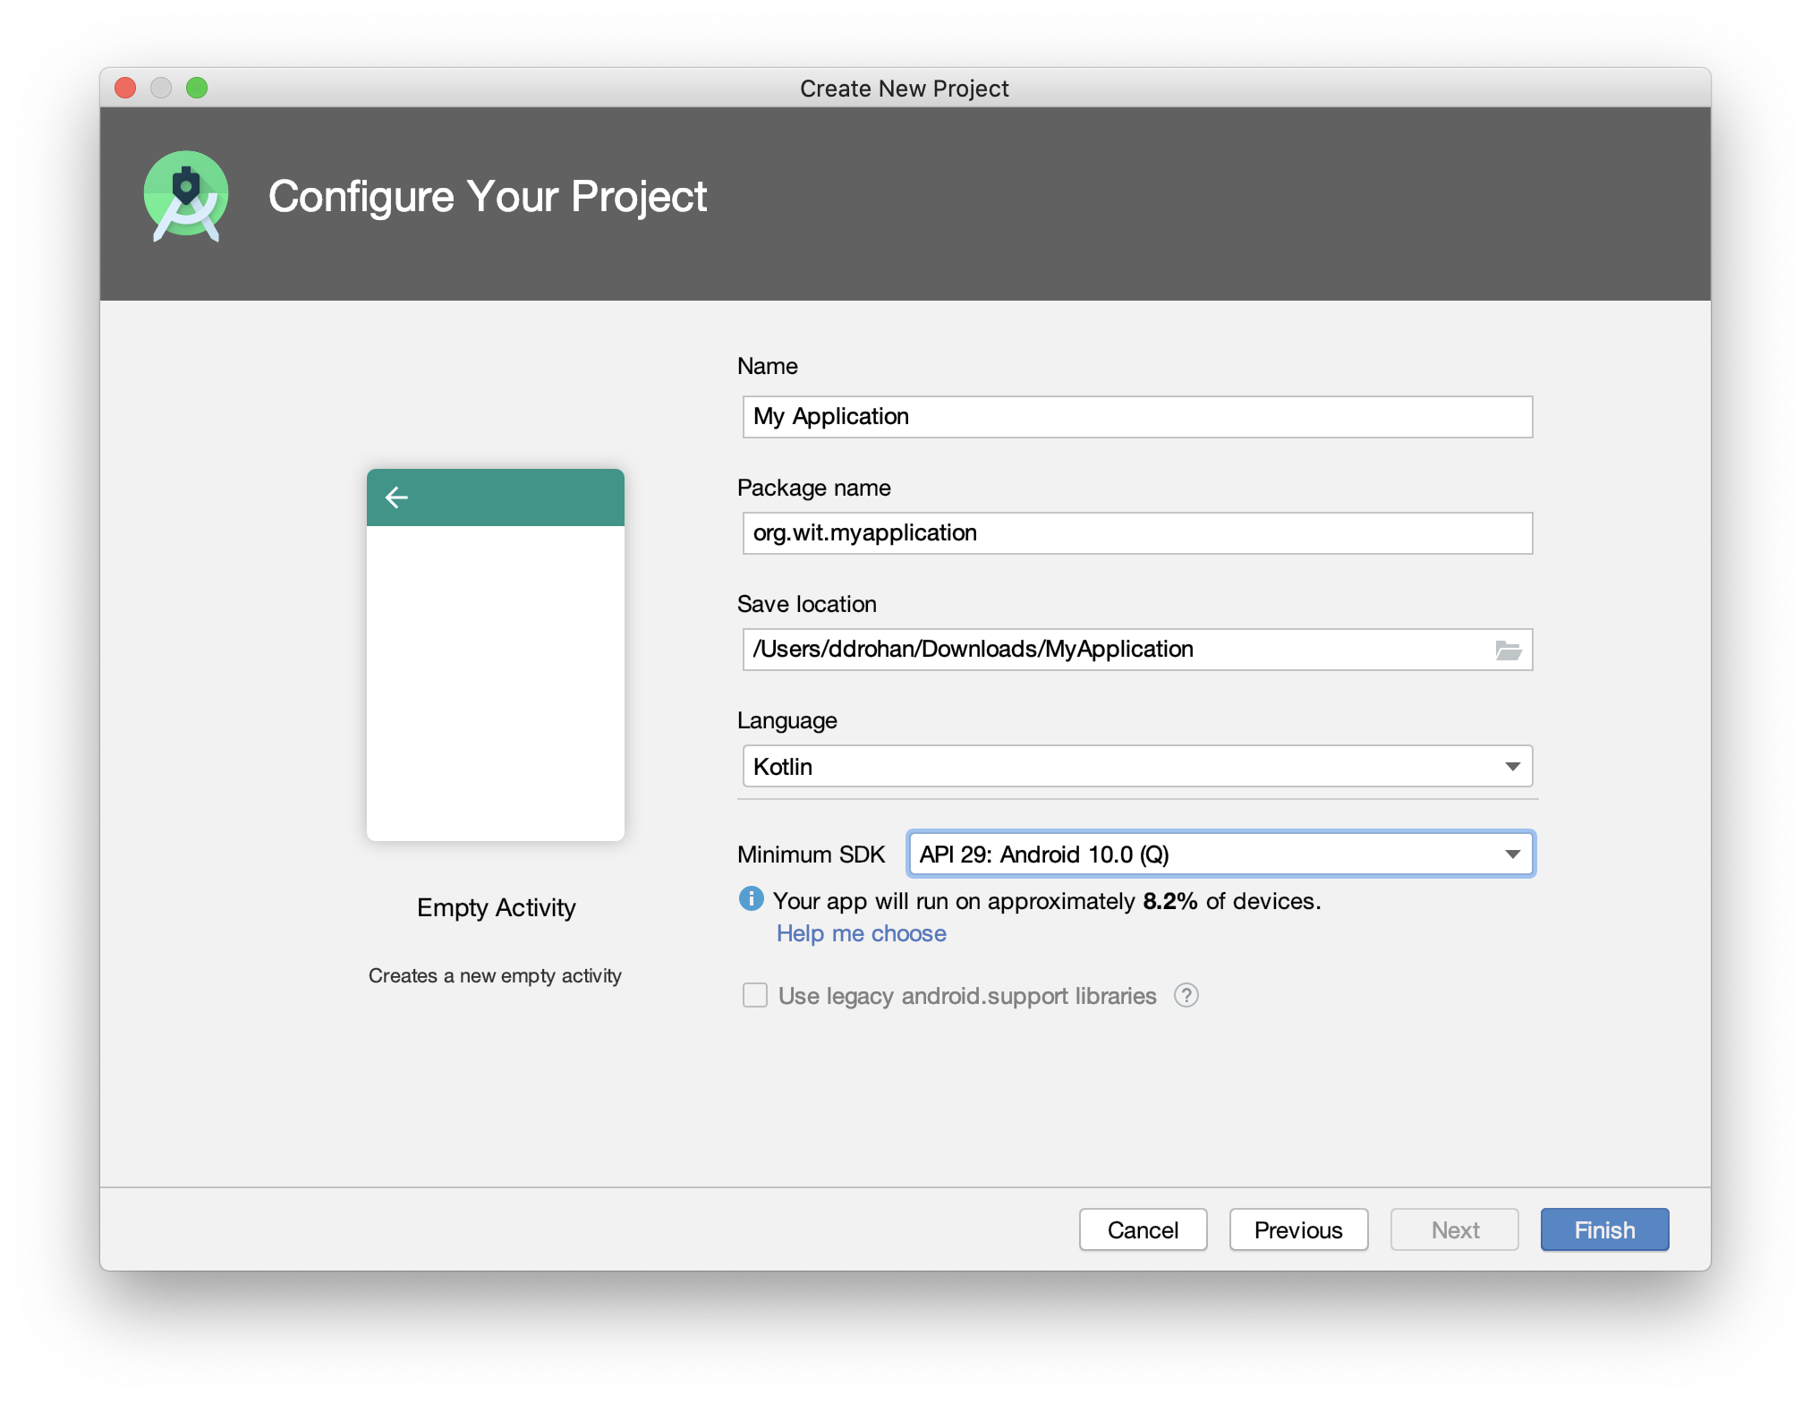
Choosing your Min SDK

Slide 23
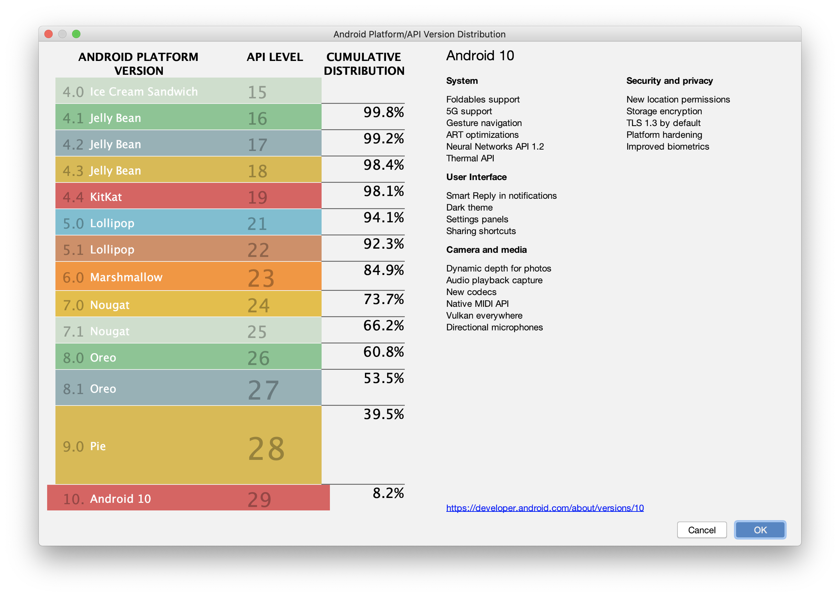

Slide 24
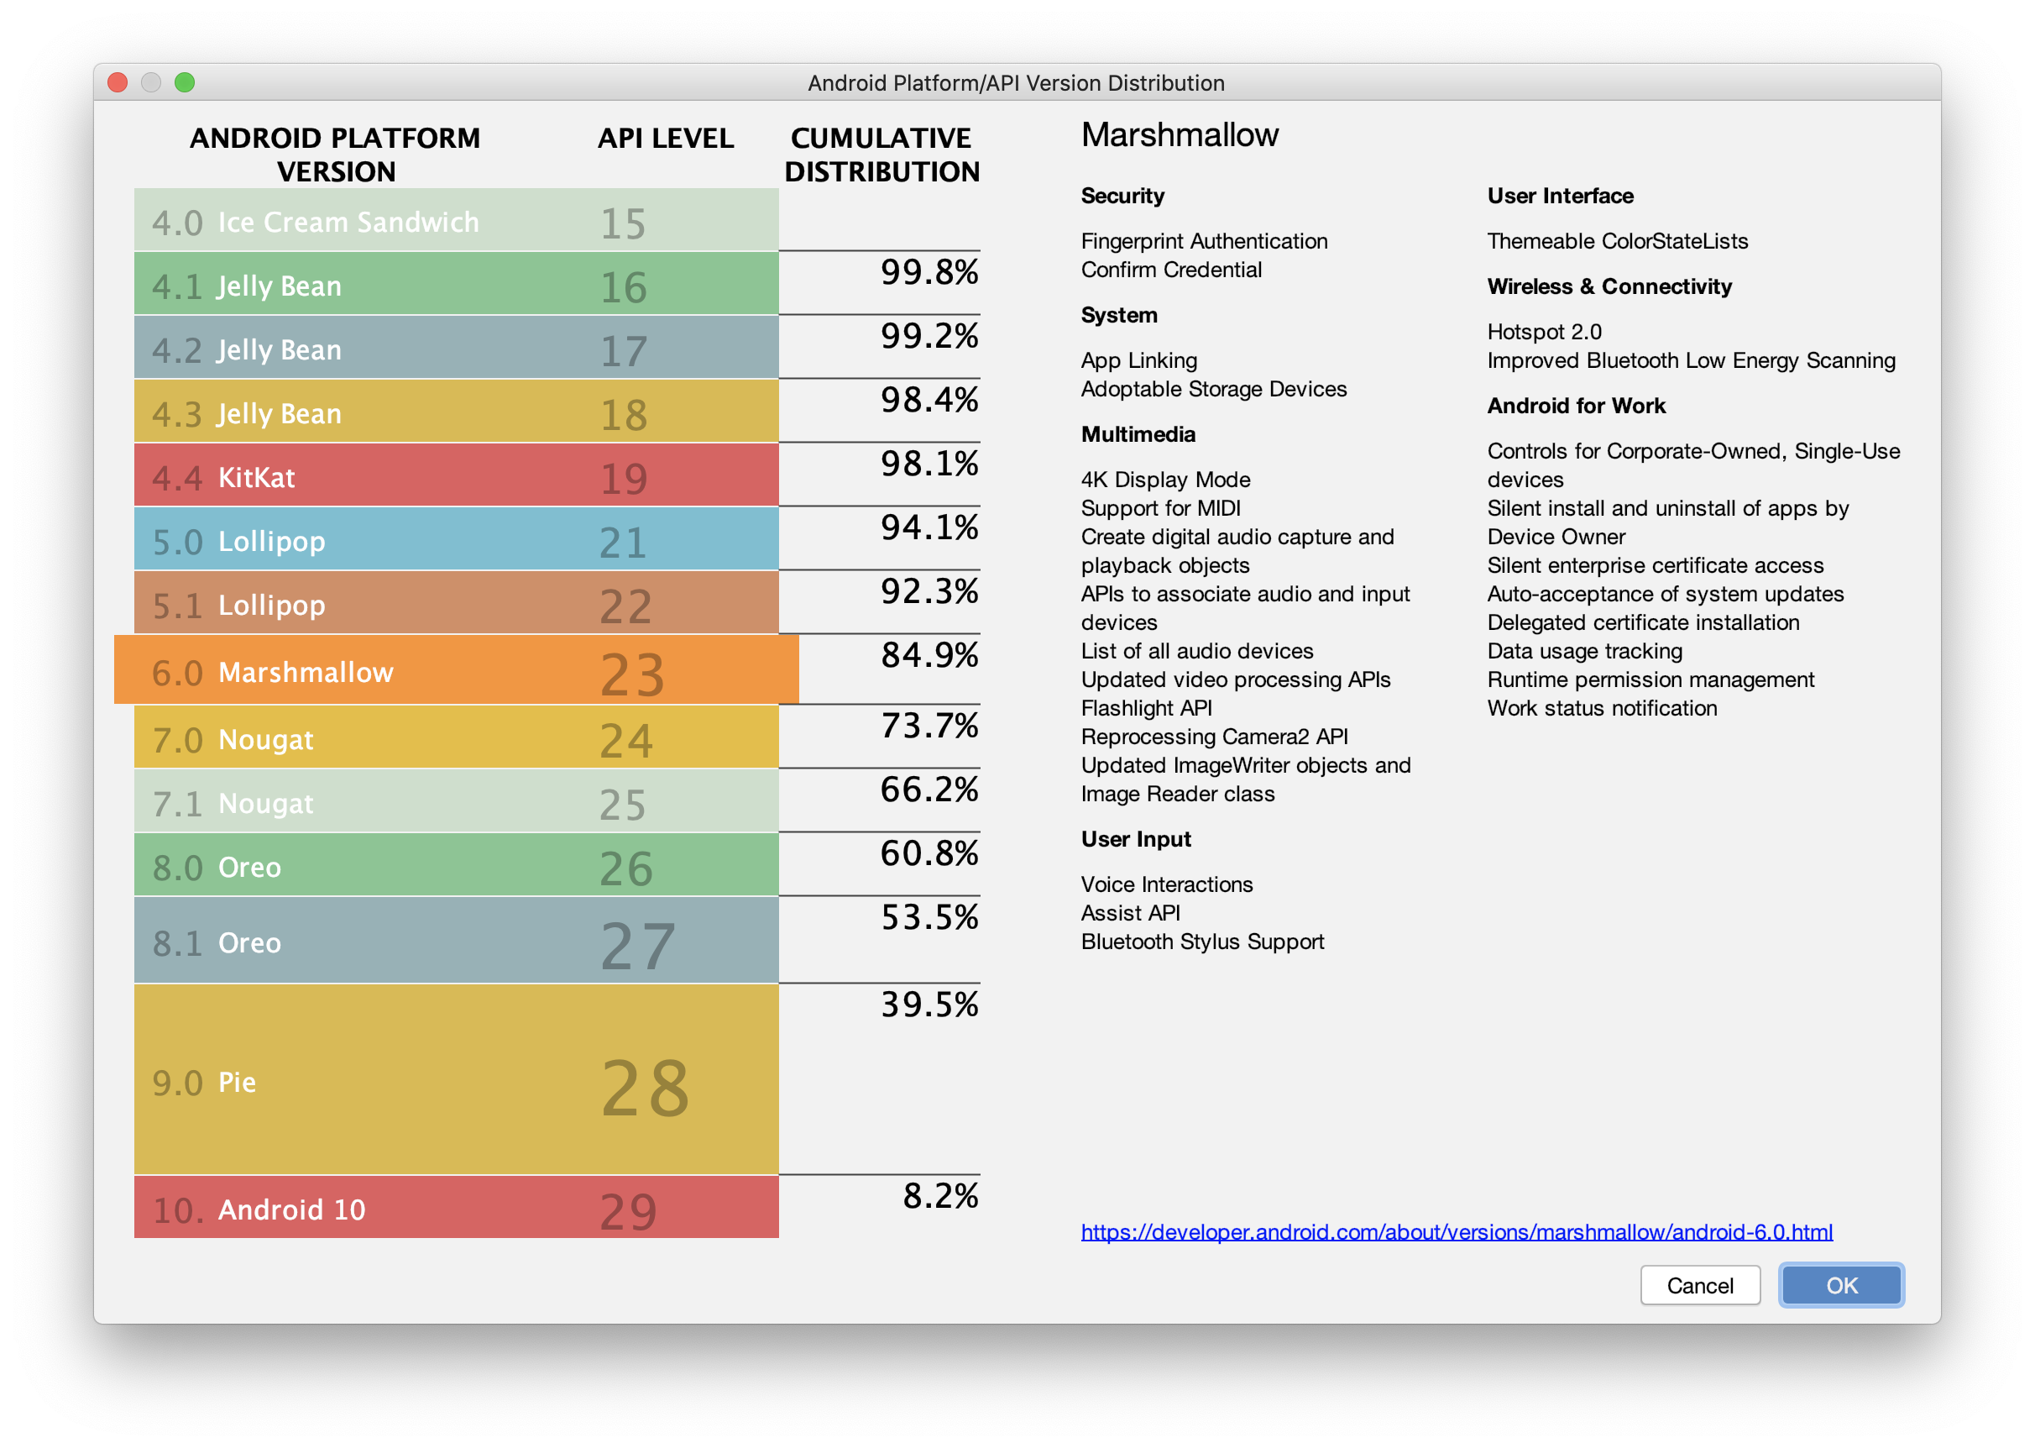
Notes:
objective may be to have an application run on as many devices as possible so shoot for the lowest API level possible. But keep in mind the distribution of Android versions on real devices out there.

Slide 25
some interesting graphics…

Slide 26
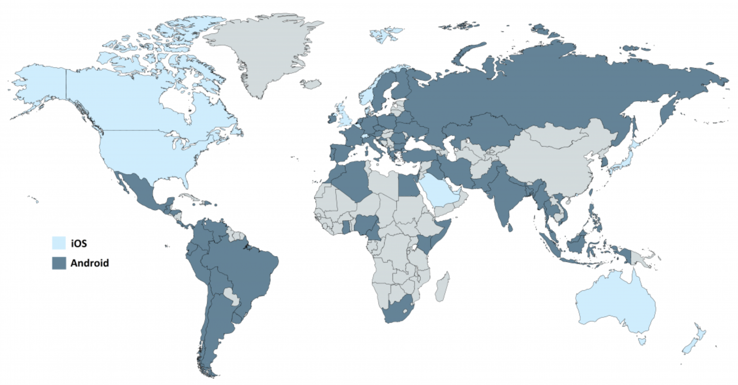
Which Countries Prefer What (Q3 2019)
https://deviceatlas.com/blog/android-v-ios-market-share
Notes:
All down to basic economics and distribution of wealth

Slide 27
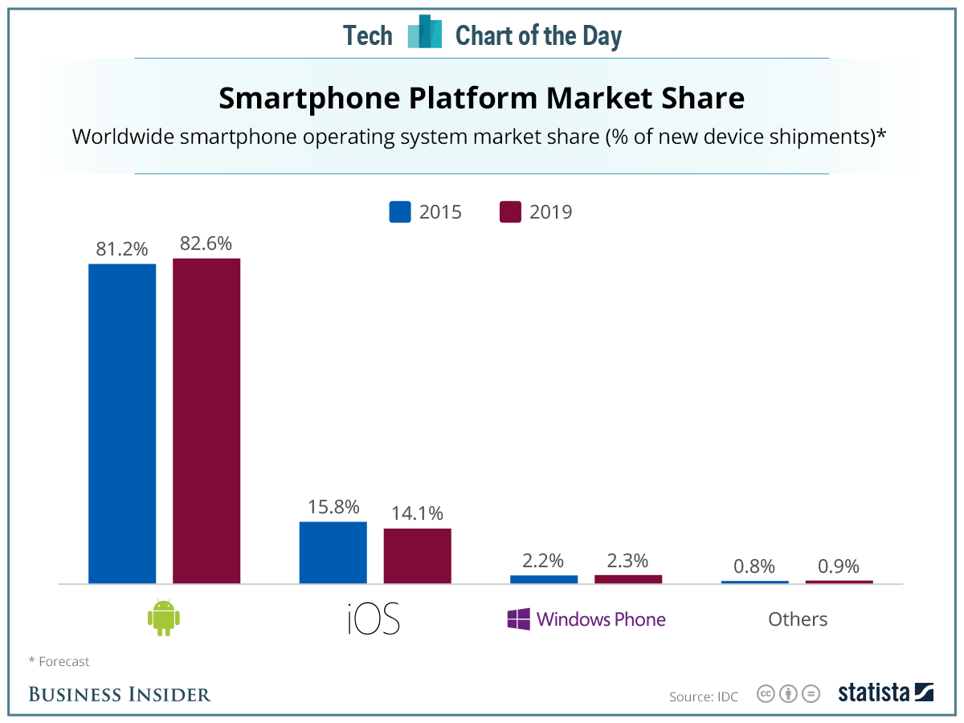
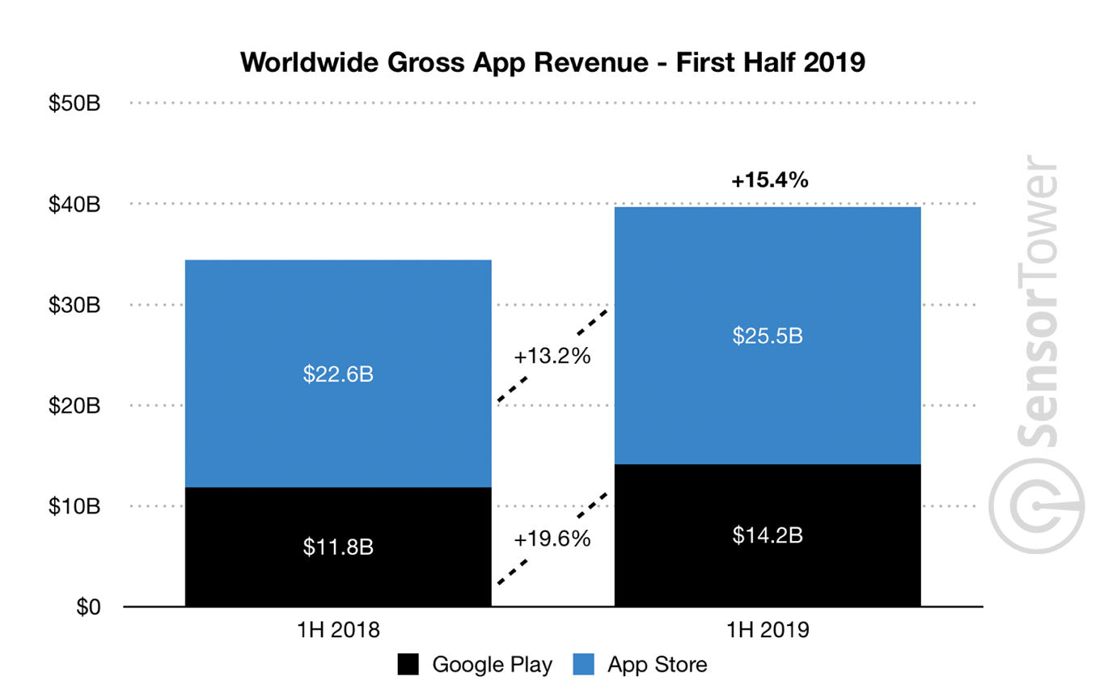
Market Share Vs App Revenue

Slide 28
some very interesting graphics… ☺

Slide 29
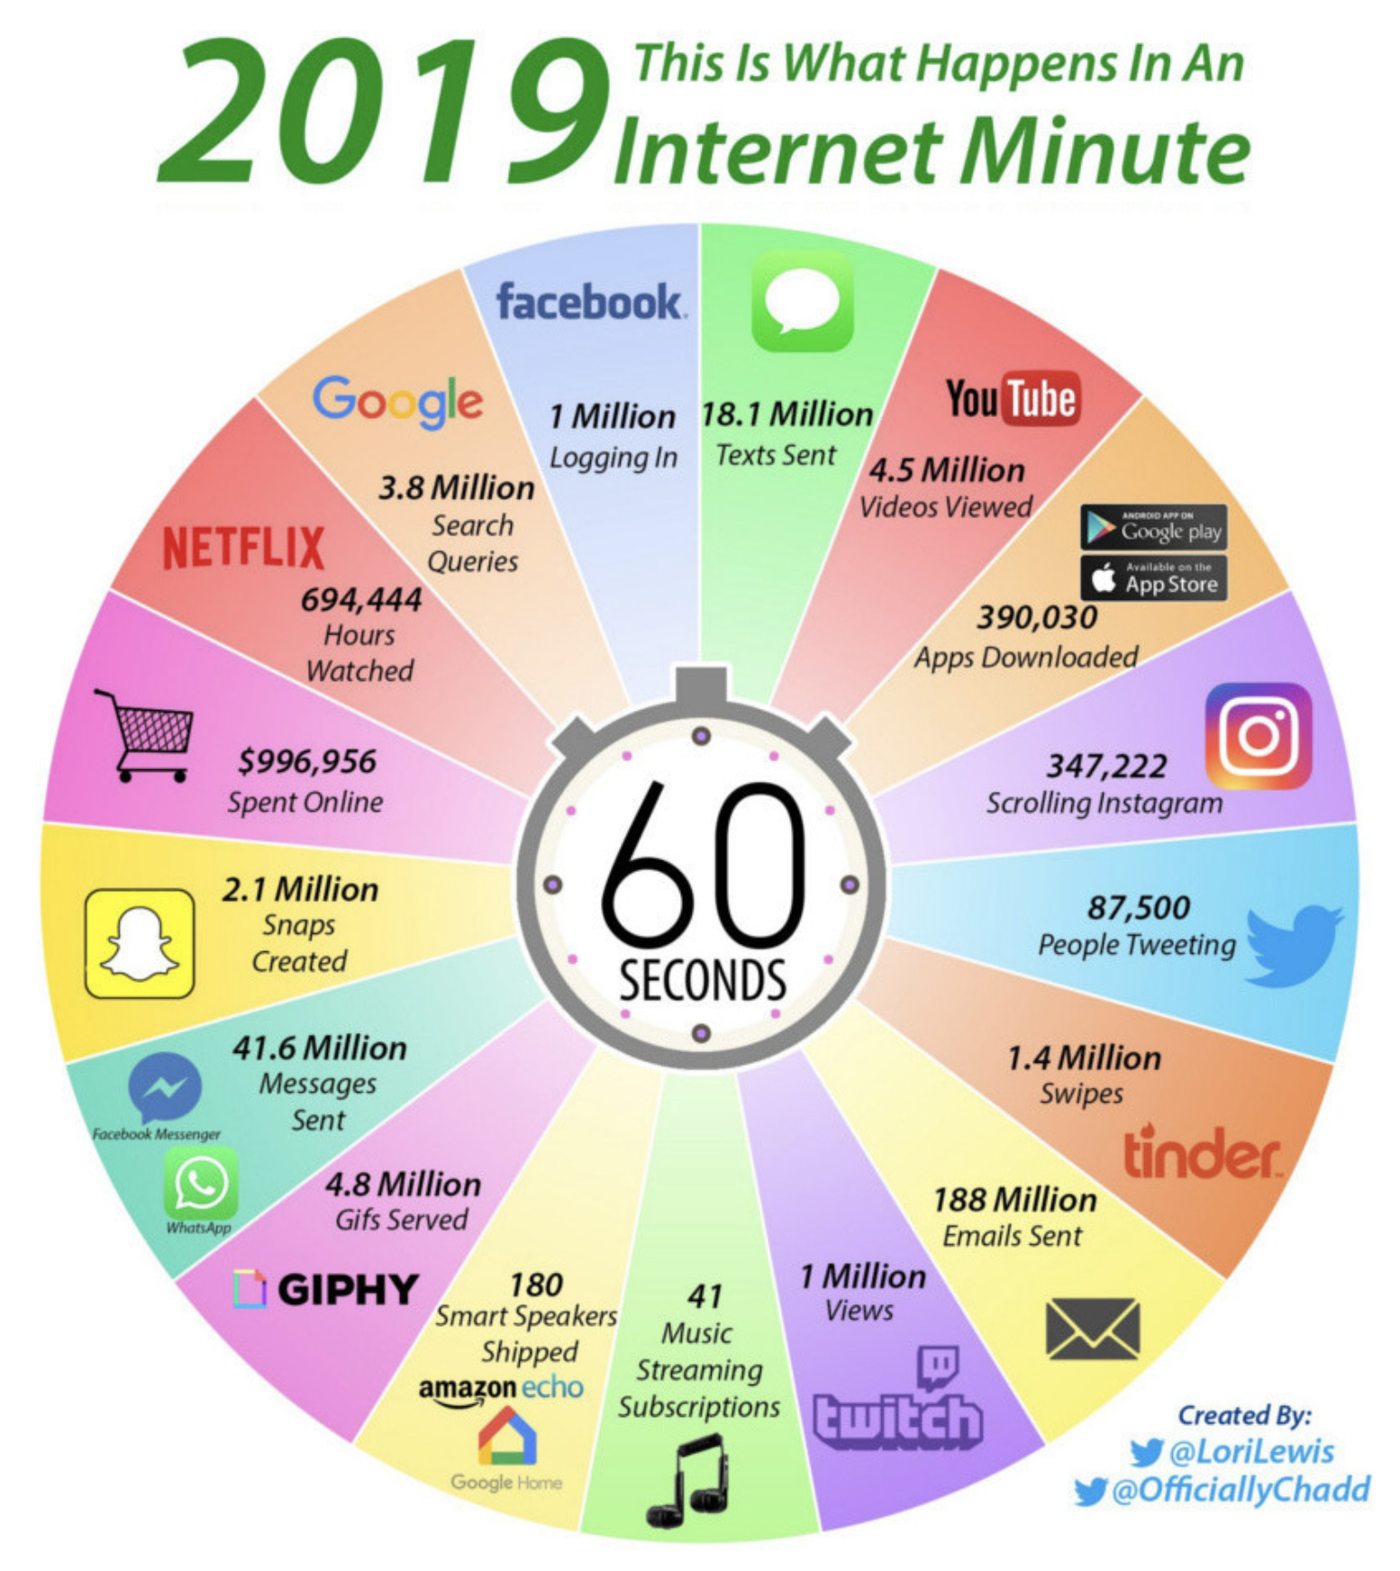

Slide 30
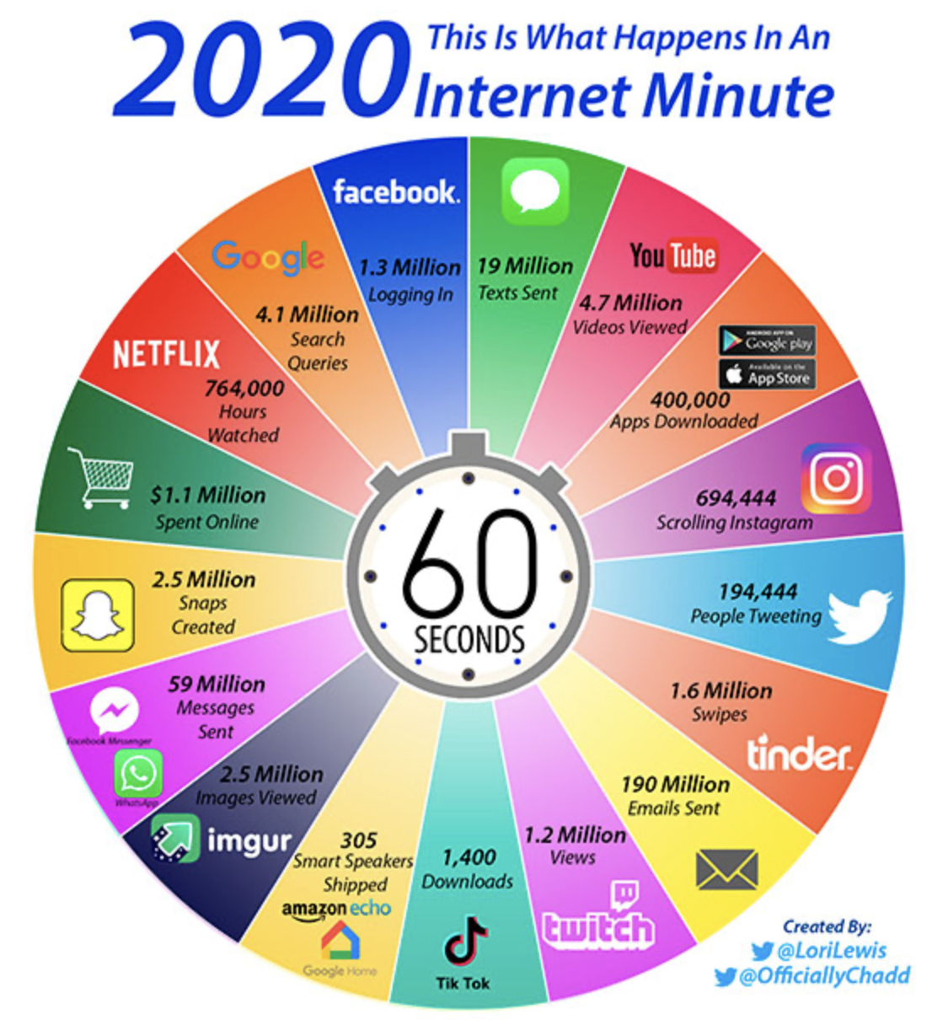
Notes:
Mobile devices probably aren’t going away anytime soon, and of the billions of people on the planet, eventually, everyone who can afford one will probably have one. BUT - All the benefits of mobile phones come at an ethical and environment cost which leads me to the next slide….

Slide 31
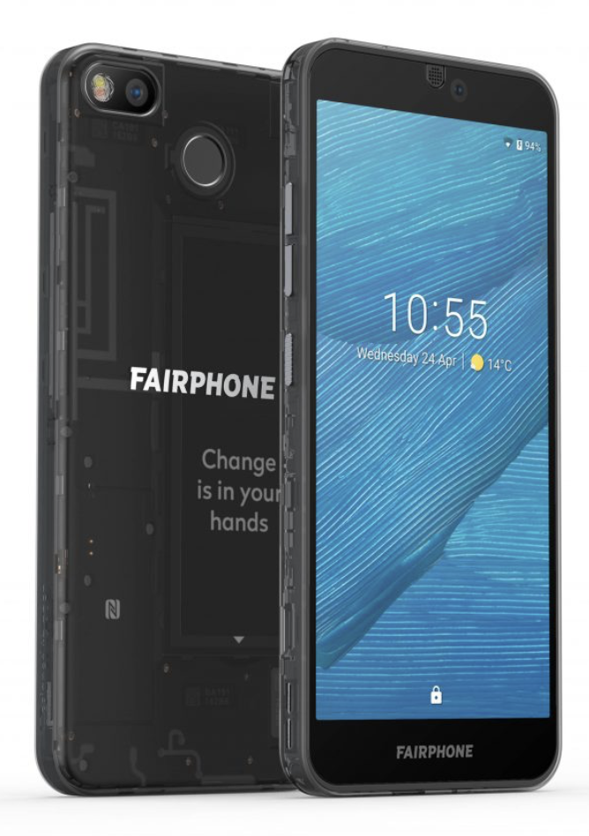
FairPhone
https://youtu.be/S0fbZerTUjY

Slide 32
References
Online references
http://developer.android.com/
By far the most important single reference.
https://www.techadvisor.co.uk/news/google-android/android-10-3689677/
https://www.zdnet.com/article/android-10-release-date-features-rumors-and-everything-we-know-so-far/
https://www.statista.com/chart/5930/adoption-of-ios-and-android-versions/
https://www.phonearena.com/news/Apple-iOS-12-adoption-rate-85-percent-Android-comparison_id116546
https://www.express.co.uk/life-style/science-technology/1136137/Android-vs-iOS-Apple-reveals-major-advantage-over-Google
https://www.androidcentral.com/android-q#theme
https://www.allaccess.com/merge/archive/31294/infographic-what-happens-in-an-internet-minute
Introduction to Android

Slide 33


